Slide 1

Stock Analysis
AIDI_1100_01
FINAL PROJECT
GROUP_4
Vaibhavi Thakkar (POC)(PA)
Shrutika Raut (PA)(PS)
Smriti Raina (PS)
Nitin Kumar (BA)
Abhishek Dadwal (BA)

Slide 2
Overview
Data Extraction
Data Storing
Stock Search
Yahoo Finance Module
Visualization and Stock Comparison
Stock Prediction

Slide 3
Data Extraction
Extracting data from the website – The process is called Web scarping
How to do Web scraping in Python?
1. Make an HTTP request to access content of a webpage
Import Requests library of Python
Pass webpage URL as a parameter to requests.get(url:) -> requests.Response() object

Slide 4
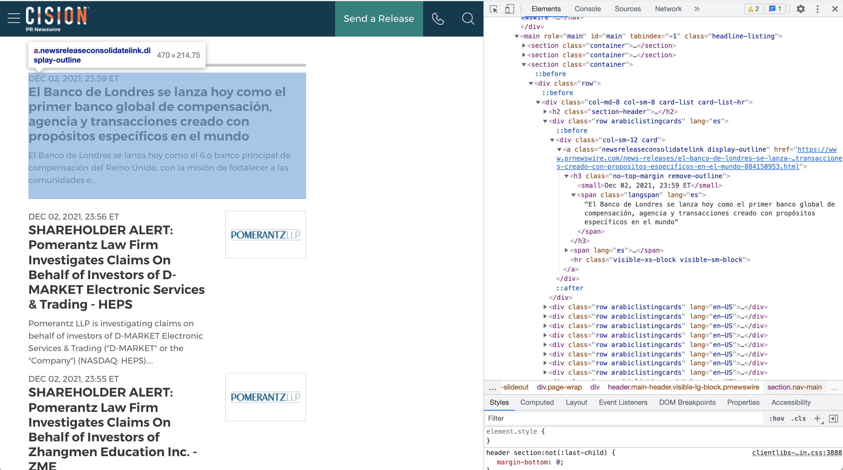
2. Parse HTML content
There are many libraries available. We would be using BeautifulSoup.
Import BeautifulSoup library of Python
Get an instance of BeautifulSoup(html_content, ‘html.parser’)
Here html_content would be Response().content
Specify the elements for which content needs to be extracted
For e.g.
child1Html = parentHtml.find_all(‘a’, class_='newsreleaseconsolidatelink’)
child2Html = child1Html.h3.text

Slide 5
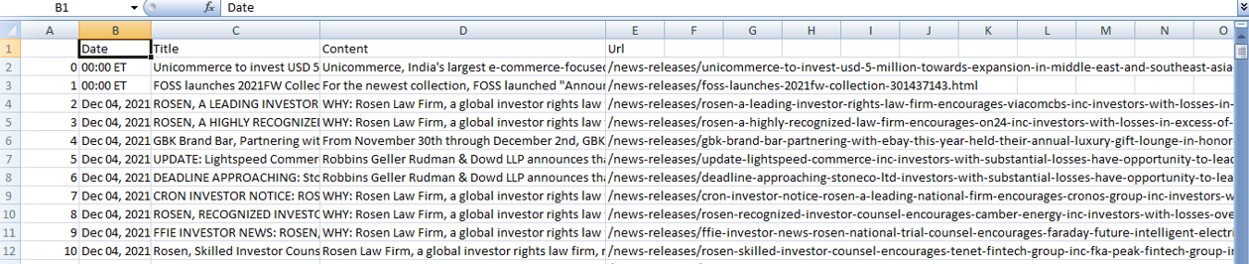
Storing the data
After scraping the required data from the news articles , we decided to store it in a CSV file.
CSV files are easy to create and convenient to use. Also, the manipulation in CSV files is fast

Slide 6

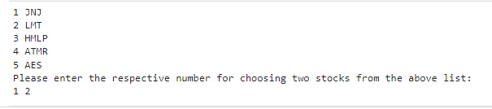
Extracting the Stock
Further, for extracting the list of stock symbols, we are using regular expressions. For example.
From the latest top stocks, we are letting the user to choose the specific stocks to be analysed.

Slide 7
Yahoo Finance
To integrate yahoo finance API below frameworks are required
install yahoofinancials
install yfinance
Function used to fetch data for yfinance is download
Input parameters : stock name , start date ,end date
Output:

Slide 8
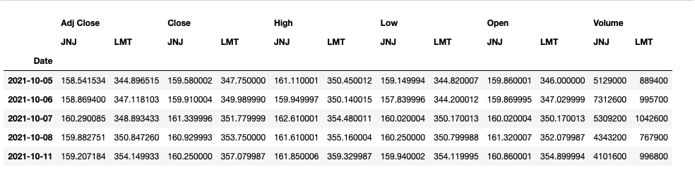
Visualization
This visualization shows some features of the two specific stocks that have been selected by the user for the last 60 days.
Adj Close(Adjusted Closing price)
Close (Final Closing price)
High (Highest for the day)
Low (Lowest for the day)
Open (Stock's opening price)
Volume (Stock total volume)

Slide 9
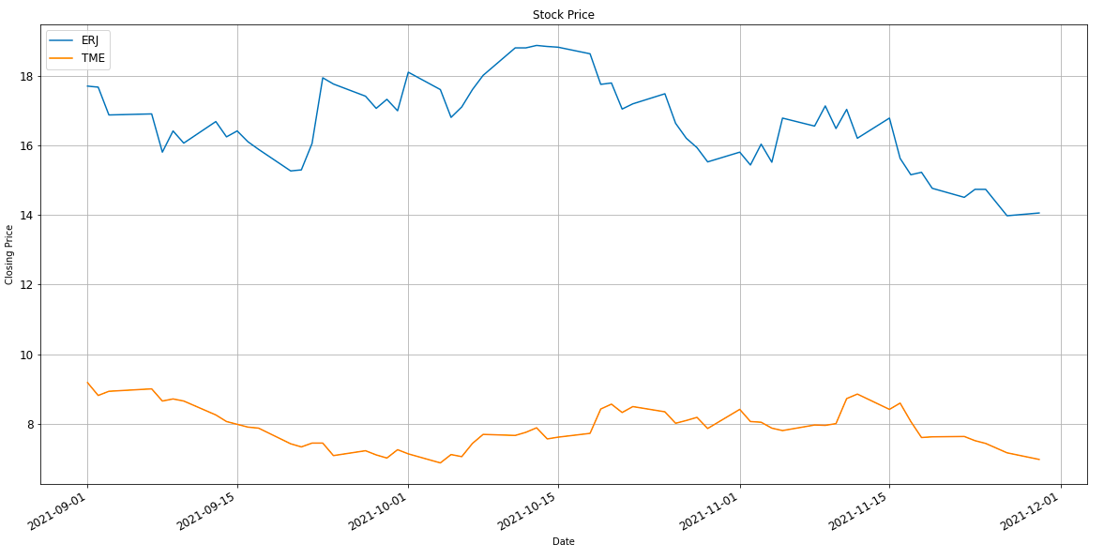
Stock Comparison
This visualization illustrates the stock's closing price
comparison of the last sixty days.
The Figure illustrate the selected stock's closing price using the line graph.
X axis depicts the timeline of the last 60 days.
Y axis depicts the closing price of the stocks.

Slide 10
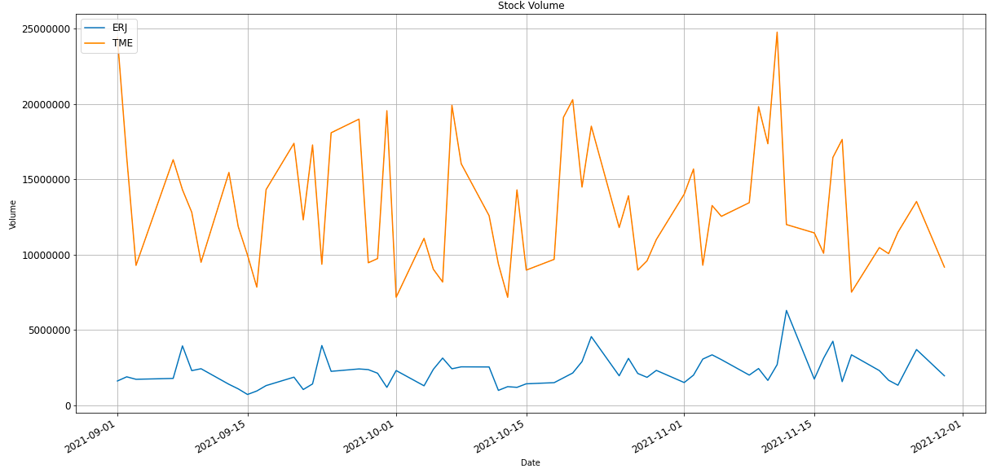
Stock Comparison
This visualization depicts the change in stock's volume
comparing with the second stock of the last sixty days.​
The Figure depicts the selected stock's Volume measure using the line graph.​
X axis depicts the timeline of the two months starting from September to January.​
Y axis depicts the numerical value.​

Slide 11
Prediction
Model used for stock prediction is Long Short-Term Memory (LSTM) networks
Here we feed Yahoo finance data of 5 years from current date and preform necessary evaluation.
Here we have used user selected stock to evaluate future stock price.

Slide 12
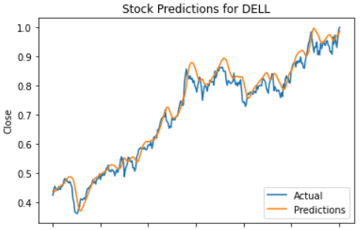
Stock Prediction
From the analysis graph its seen that stock for Dell for past 5 years
The graph shows fluctuating close value from past 5 years.
It can be predicted that the value will be decreasing for the upcoming days and hence its recommended not purchase the Dell stock.
Date

Slide 13
Thank you

